Slide 1
School Site Council
Meeting #3
February 22, 2022

Slide 2
—Albert Einstein
“The measure of intelligence is the ability to change”

Slide 3
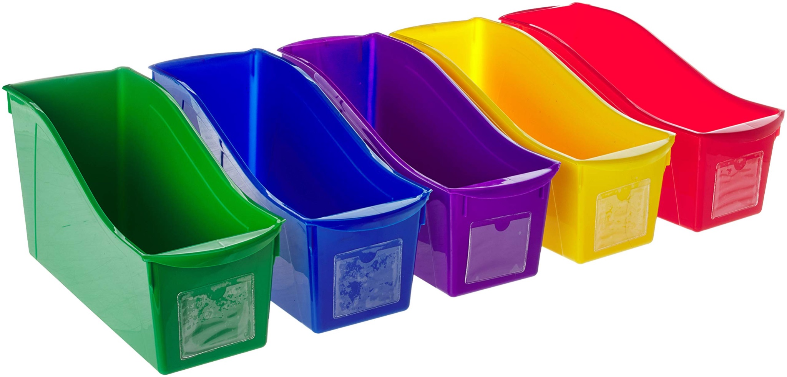
Budget Balance Remaining
Potential Uses
Title 1 for 2022-2023
The allocation for AFCS for this school year is $198,657.
7 Instructional Aides are being employed for a total of $182,200.
This leaves about $16,457.00 for us to consider using with the guidance of Title One guidelines.
Level 1 - 25 students books $225
Level 1 - 5 teacher books $75
Level 3 - 5 student books $45
Level 3 - 2 teacher books $30
Total cost $375
Vote #1
Vote #2
Book Bins
Phonics for Reading
Authorized use of funds

Slide 4
LCAP Goal Review
Safety Plan Survey to SSC Members
Notes:
TK-8 Began Positive Discipline Training (safe, nurturing learning environment)
TK-8 Intervention review -

Slide 5
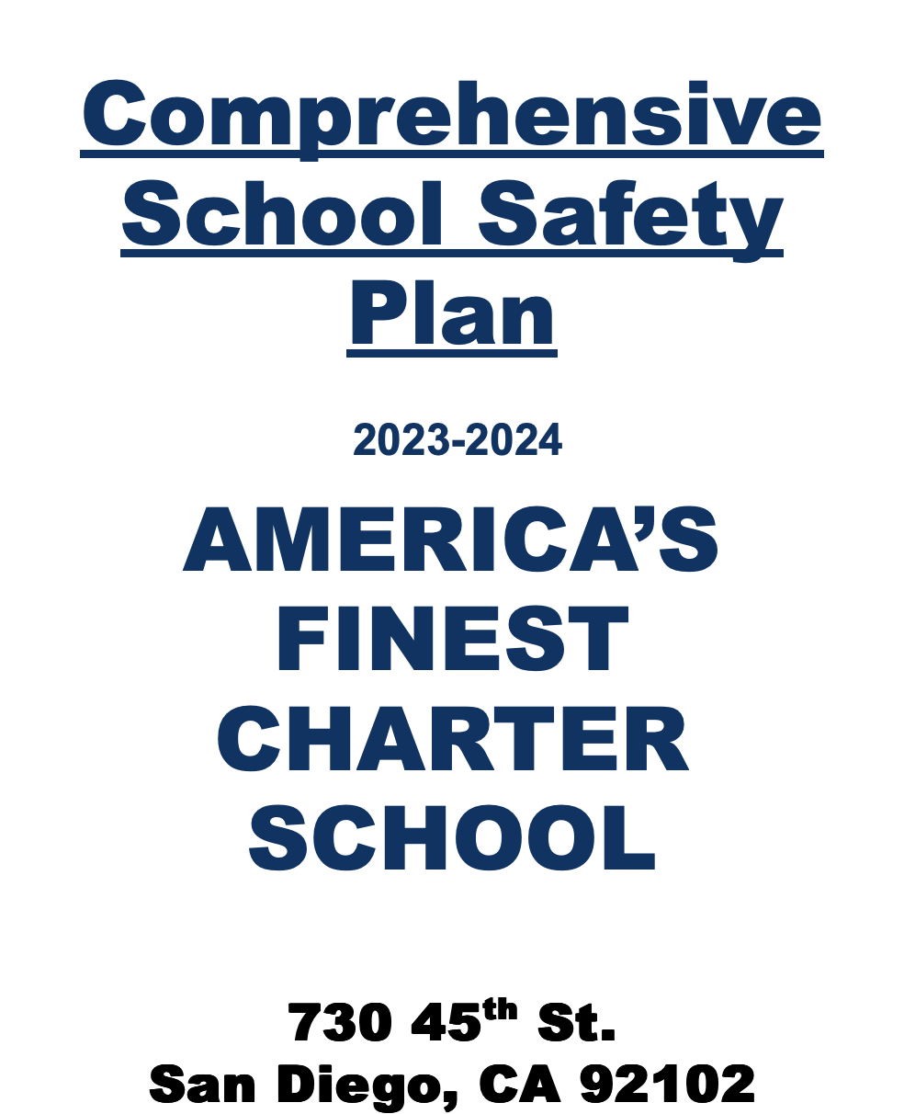
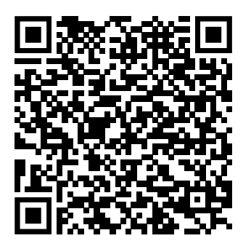
School Safety Plan
Form result analysis together :)
School Safety Plan

Slide 6
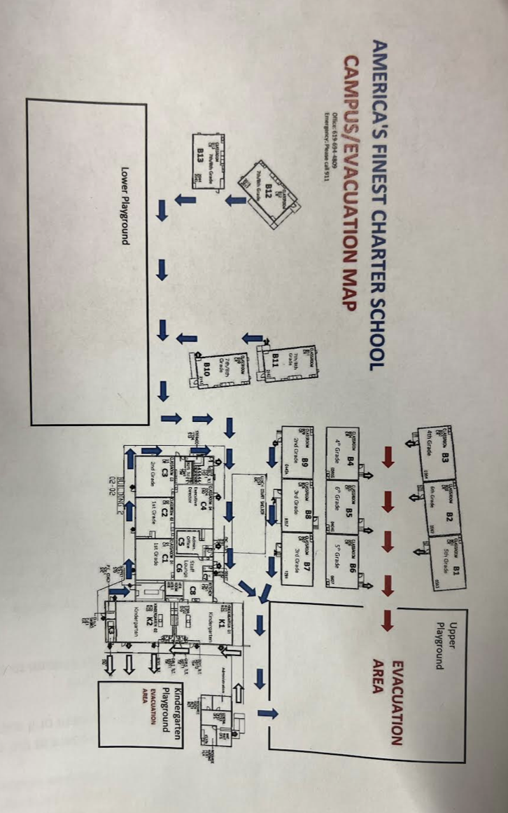
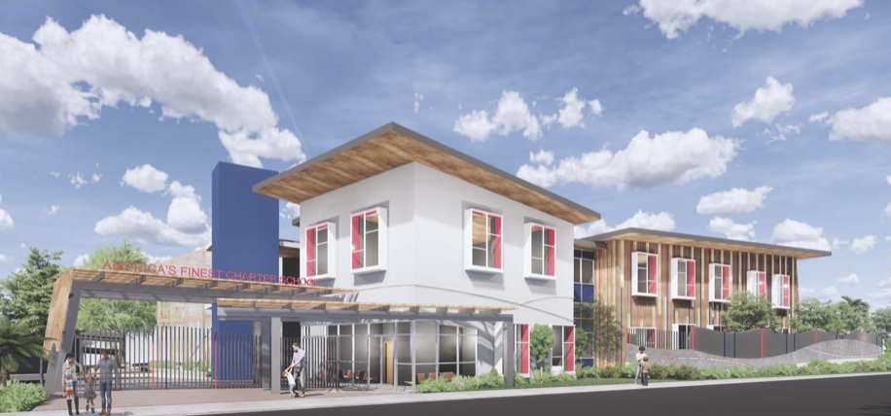
School Safety Plan

Slide 7
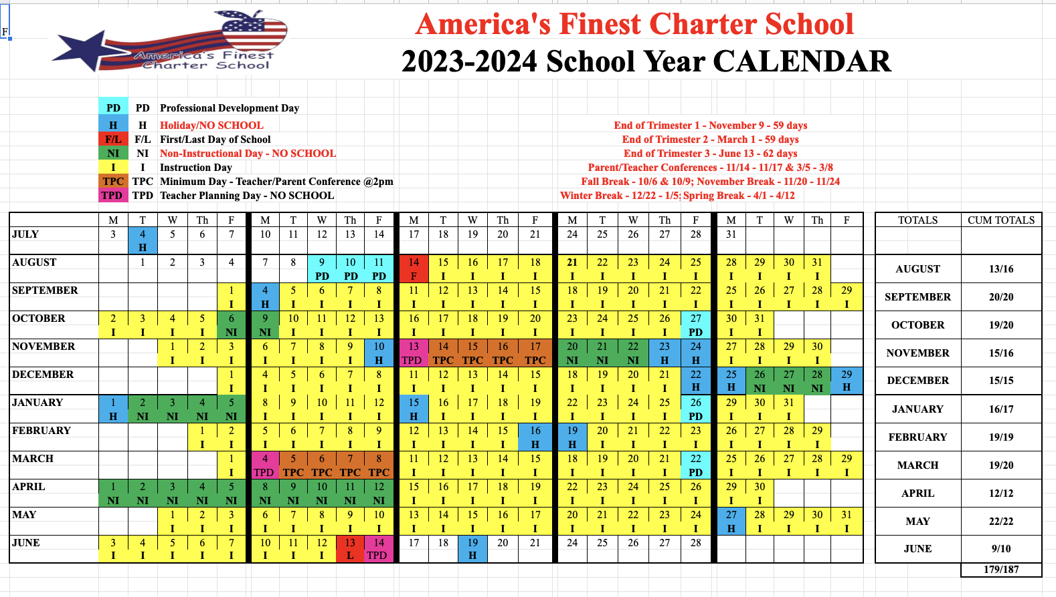
School Calendar- Ideas for 2023-2024
Draft
Survey

Slide 8
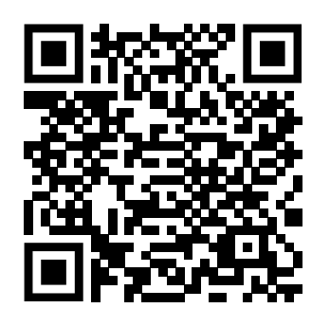
SARC - Updated and Published
https://sarconline.org/public/print/37683380136663/2021-2022

Slide 9
Upcoming Events
DELAC Calendar - Next March 15 at TK-8 site 9-10am
Science Night - March 21st 4:00pm-6:00pm @ the TK-8
KPBS “Neighbor Day” - March 25th 9am-12pm

Slide 10
Record of Dates + Looking Ahead
All meetings are scheduled and we are looking forward to engaging and building a
better community with you all on the following dates with the following tentative topics.
November 2, 2022 TK-8 site in Room B10 | What is a SSC? Reviewing rules, regulations, and electing major roles. Notes
December 14, 2022 High School Site: 4481 Estrella Ave, 92115 | What is a SSC? Reviewing rules, regulations, and electing major roles part 2. Updated Title 1 budget. Building our sub-committees and delegating of roles and responsibilities, Understanding the LCAP, getting our name out into the community, acquiring testimonials, parent satisfaction survey, expanding and reviewing our HS program. Establishing Parent Consideration Committee.
February 22, 2023 TK-8 site in Room B10 | ELPAC Assessment Updates, reviewal of enrollment procedures, site, and process. LCAP Draft Recommendations. Reviewal of school safety plan and modified plan during construction of new school site.
April 14, 2023 High School Site: 4481 Estrella Ave, 92115 | CAASPP Assessment Update, LCAP reviewal and considerations for 23-24. Overview of upcoming construction and procedures.
June 12, 2023 TK-8 site in Room B10 | Key takeaways for building a stronger school for 2023-2024. Outreach to TK-K
For more info: https://www.americasfinestcharterschool.org/school-site-council
*All meetings are at 5:30pm*

Slide 11
Adjournment
Secretary Marcus- please email notes to: tbagby@americasfinestcharterschool.org
cstruyk@americasfinestcharterschool.org
abecker@americasfinestcharterschool.org

