Slide 1
School Site Council
Meeting #2
December 14th, 2022

Slide 2
—Margaret Wheatley
“There is no power for change greater than a community discovering what it cares about.”

Slide 3
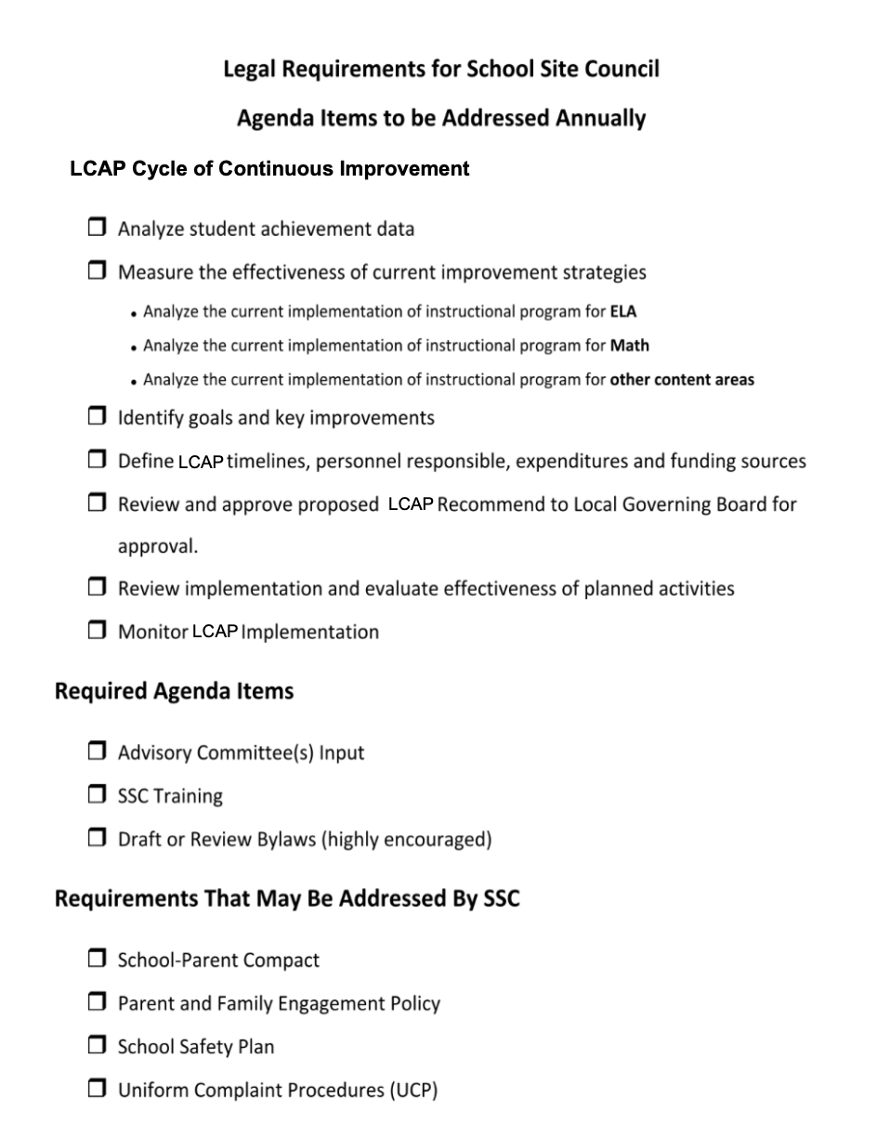
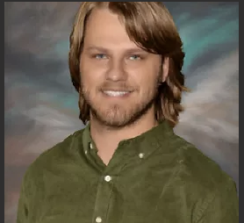
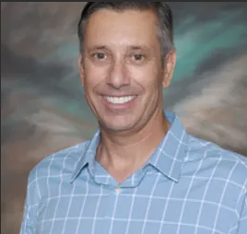
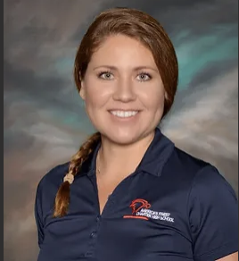
SSC Role and Function
What is the role and function
of an SSC?
Mr. Struyk
Mr. Becker
Ms. Marcus
Will take on the role of President/Chair and will lead meetings, report to the Board of Directors, and help organize sub-committees.
Will take on the role of Vice-President/Chair where he will help lead sub-committees and fill in for Chair in absence.
Will take on the role of Secretary and has the executive function of taking notes at all SSC meetings

Slide 4
Star notes of Meeting #1
01
02
03
The students
The families
The community
The ones with the most malleable minds.
The ones who care deeply, but are sometimes so busy.
Those who we can make partnerships with and bring in for expanded success.
The Commonality
Communication
How do we make things easier, safer, or more accessible?
What areas should we target?
The role of the SSC
Notes:
Motion of minutes

Slide 5
Budget Update
Title 1 for 2022-2023
The allocation for AFCS for this school year is $198,657.
7 Instructional Aides are being employed for a total of $182,200.
This leaves about $16,457.00 for us to consider using with the guidance of Title One guidelines.
Authorized use of funds

Slide 6
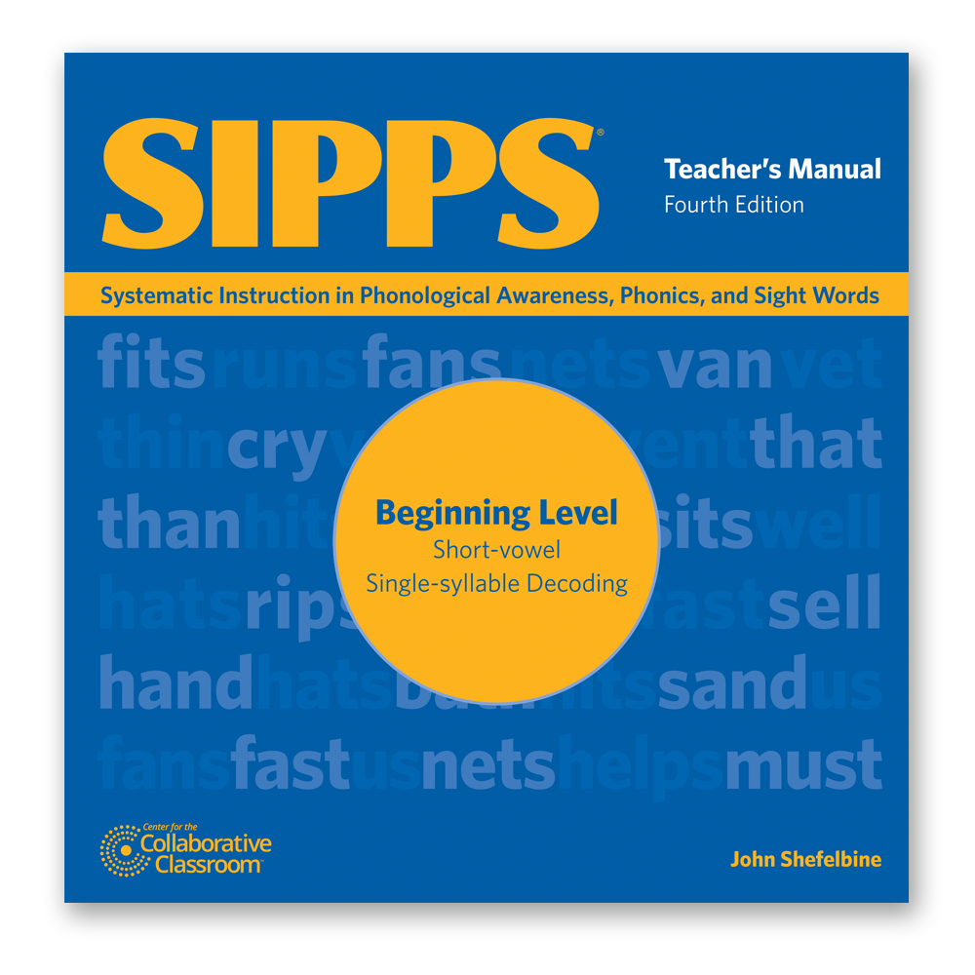
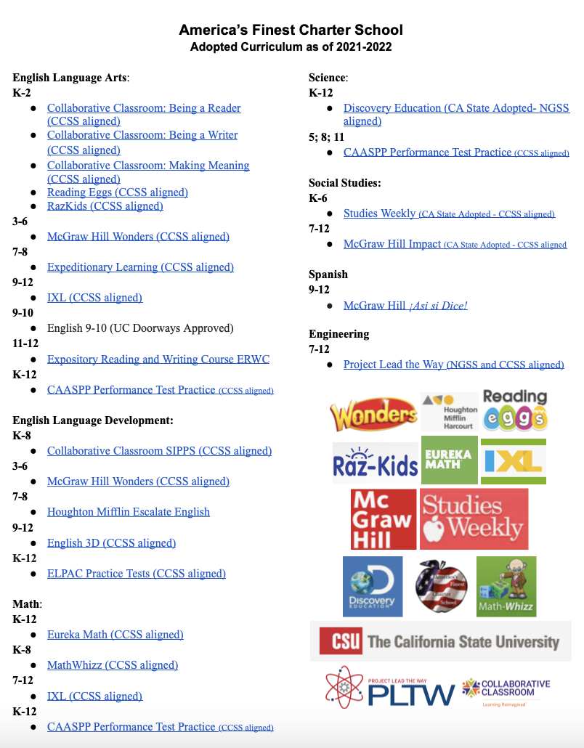
LCAP Goal Review
Curriculum List
https://docs.google.com/document/d/1KSm_82qICMgXZYkVZq6iDmaPshXIQx2tMPPlDQnE6f0/edit?usp=sharing
Notes:
TK-8 Began Positive Discipline Training (safe, nurturing learning environment)
TK-8 Intervention review -

Slide 7
LCAP Goal Review
Data
Notes:
iReady ELA

Slide 8
Meeting student needs: SIPPS

Slide 9
LCAP Goal Review
Data
Notes:
iReady Math

Slide 10
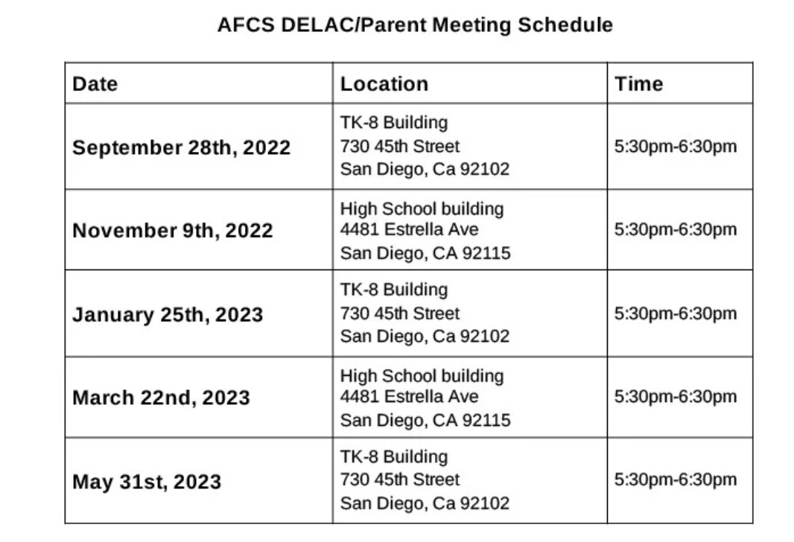
LCAP Goal Review
DELAC: https://www.americasfinestcharterschool.org/district-english-learner-advisory-committee
Notes:
18 student Reclassified - ____% (up from 7% last year)
Newcomer ELD

Slide 11
LCAP Goal Review
A - Active global citizens who demonstrate compassion for others regardless of culture, race or religion and contribute to the well-being of the school.
F - Functioning scholars in the 21st Century who use technology to share ideas, organize information, and conduct research while exploring ideas about college and careers.
C - Critical thinkers who ask questions and synthesize information, connect concepts across subject areas, and apply knowledge to real life situations in order to solve problems.
S - Successful communicators who exchange ideas both written and orally, listen closely and ask for clarification and work cooperatively with one another.
Notes:
Victor + Isaac walk around w/Alli

Slide 12
Record of Dates + Looking Ahead
All meetings are scheduled and we are looking forward to engaging and building a
better community with you all on the following dates with the following tentative topics.
November 2, 2022 TK-8 site in Room B10 | What is an SSC? Reviewing rules, regulations, and electing major roles. Notes
December 14, 2022 High School Site: 4481 Estrella Ave, 92115 | What is an SSC? Reviewing rules, regulations, and electing major roles part 2. Updated Title 1 budget. Building our sub-committees and delegating of roles and responsibilities, Understanding the LCAP, getting our name out into the community, acquiring testimonials, parent satisfaction survey, expanding and reviewing our HS program. Establishing Parent Consideration Committee.
February 22, 2023 TK-8 site in Room B10 | ELPAC Assessment Updates, reviewal of enrollment procedures, site, and process. LCAP Draft Recommendations. Reviewal of school safety plan and modified plan during construction of new school site.
April 14, 2023 High School Site: 4481 Estrella Ave, 92115 | CAASPP Assessment Update, LCAP reviewal and considerations for 23-24. Overview of upcoming construction and procedures.
June 12, 2023 TK-8 site in Room B10 | Key takeaways for building a stronger school for 2023-2024. Outreach to TK-K
For more info: https://www.americasfinestcharterschool.org/school-site-council
*All meetings are at 5:30pm*

Slide 13
Adjournment
Secretary Marcus- please email notes to: tbagby@americasfinestcharterschool.org
cstruyk@americasfinestcharterschool.org
abecker@americasfinestcharterschool.org

